Slide 1
Referee signals recognition in basketball
Pietro Fronza, Simone Compri

Slide 2
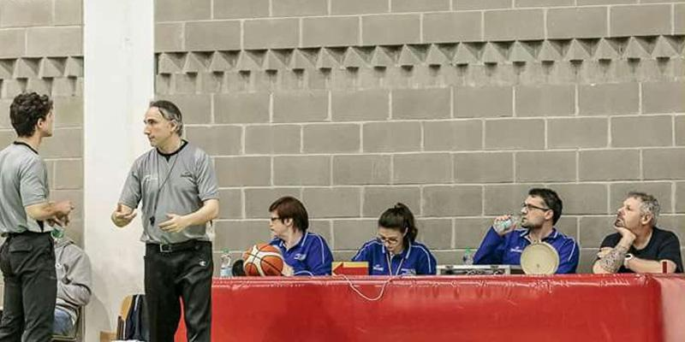
Problem Description
A common problem during a basketball match regards the timer management.
In fact, it should be stopped in response to some signals from the referee.
Unfortunately, this job is not so simple, and the task is usually entrusted to the scorekeeper.
Very prone to error due to human interaction.

Slide 3
State of the art

Slide 4
State of the art

Slide 5
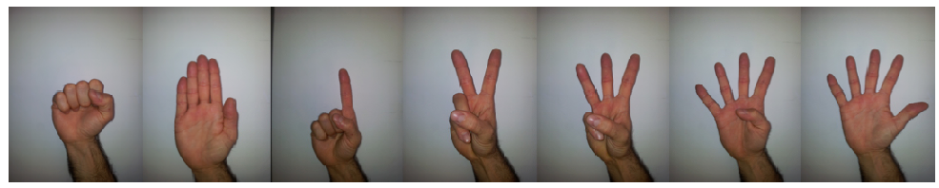
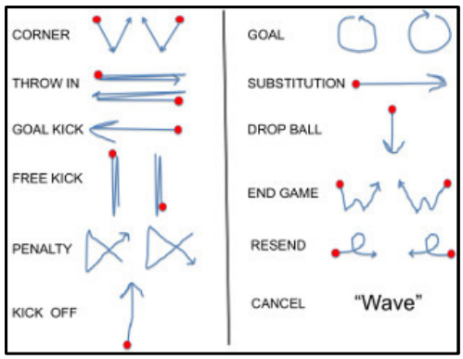
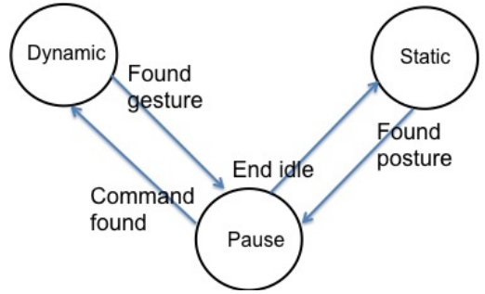
Vision Based Referee Sign Language Recognition
Gesture feature divided in:
Static
Hand feature extraction with Kinect
SVM (with centroid distance) for hand posture classification (98,2% accuracy)
Dynamic
Gesture scored against 11 HMMs (Referee CommLang)
Finite state machine for transitions between systems
Dataset: four users performing the set of commands in front of the camera

Slide 6
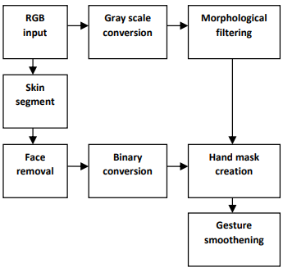
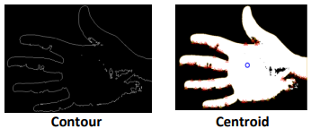
Hand Signs recognition using ML and DL
Capturing gesture input
Pre-processing for noise reduction
Face region identification
Relevant feature extraction
Input -> Contour -> Centroid
Recognition models (cross validation and trained models)
SVM
CNN (4 convolutional layers and 2 fully connected)
Custom dataset created in real time
Results (accuracy)
 | ASL gestures | Action gestures
CNN | 97% | 93%
SVM | 84% | 80%

Slide 7
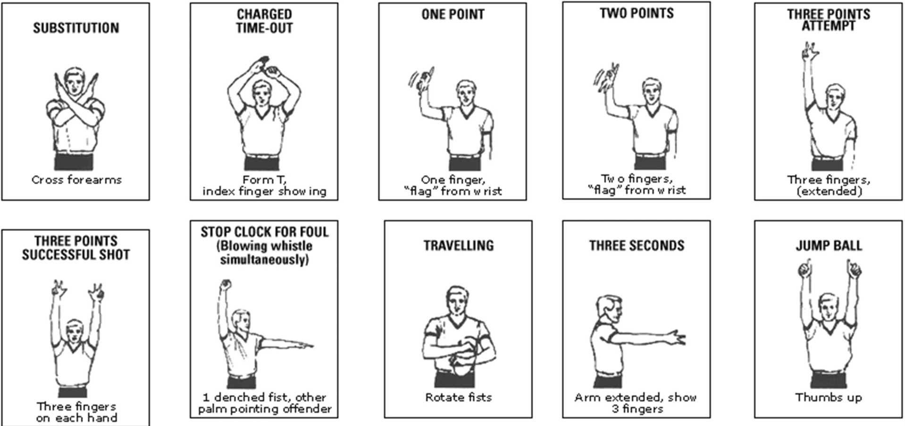
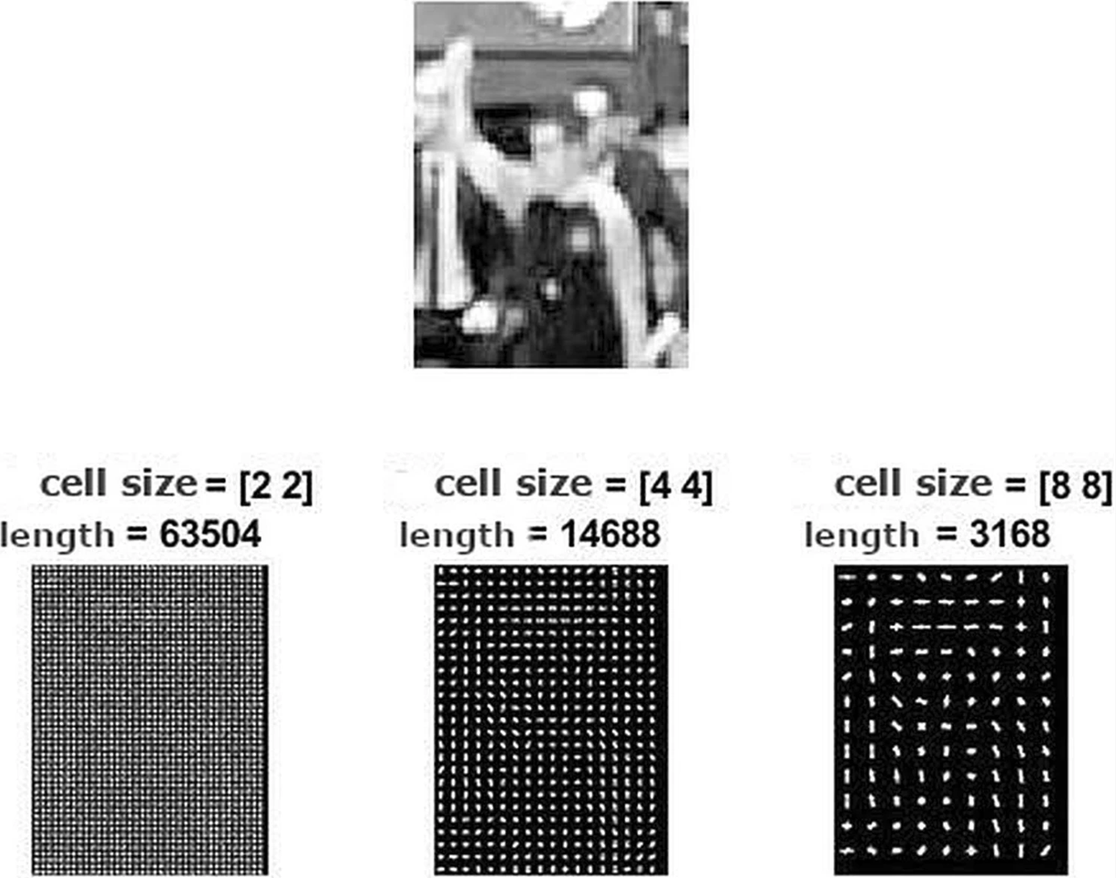
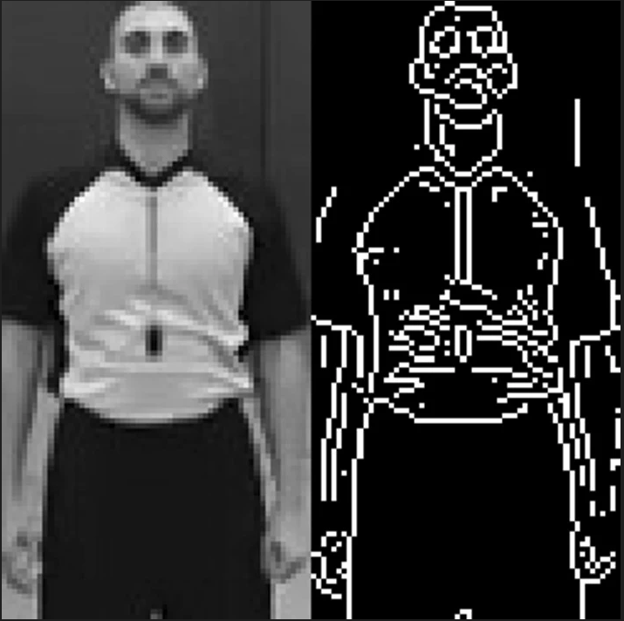
Basketball Referee Signal
Recognition of basketball referee signals from real-time videos
Julius Žemgulys, Vidas Raudonis, Rytis Maskeliūnas, Robertas Damaševičius
Image preprocessing
Sobel operator for edge detection
Extraction of HOG features (image cropped to 128 x 64 pixels)
Extraction of LBP features
SVM for classification
For classification was used Region-Of-Interest.
Non-maximum suppression (NMS) to eliminate overlapping windows.

Slide 8
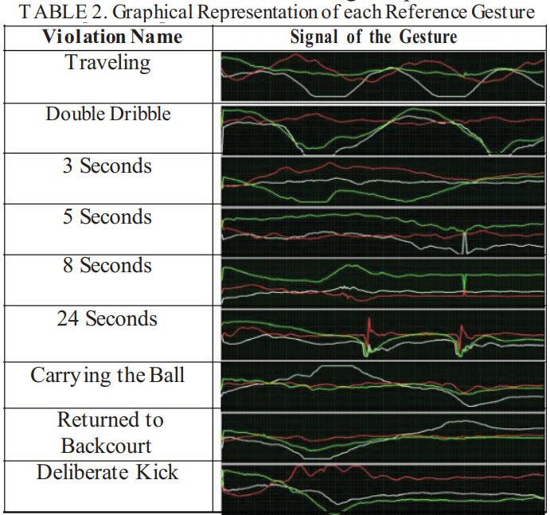
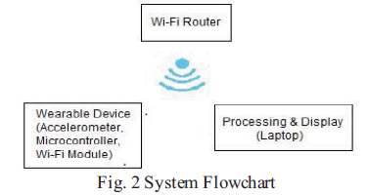
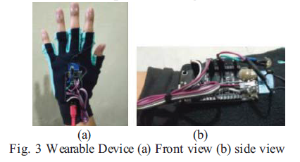
Referee Signals recognition with wearable devices
Very high accuracy.
HOG and LBP for image segmentation.

Slide 9
What we are going to do?

Slide 10
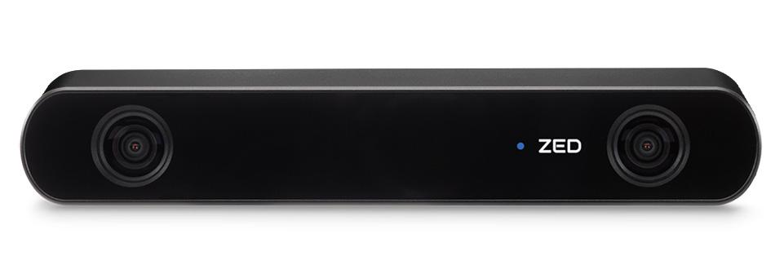
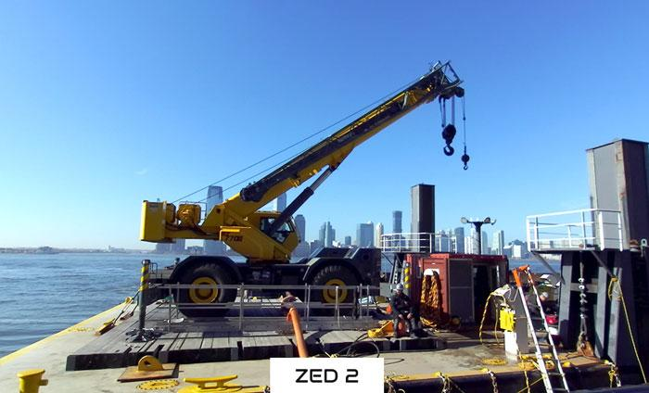
ZED cam
Neural depth sensing
Ultrawide field of view with low distortions
Complete sensor stack
Thermal control
Simultaneos localization and mapping
Floor plane detection
Skeleton tracking
1
2
3

Slide 11
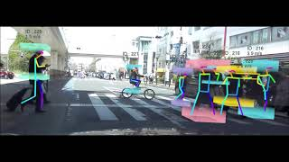
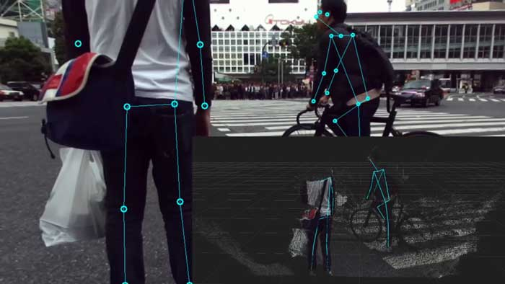
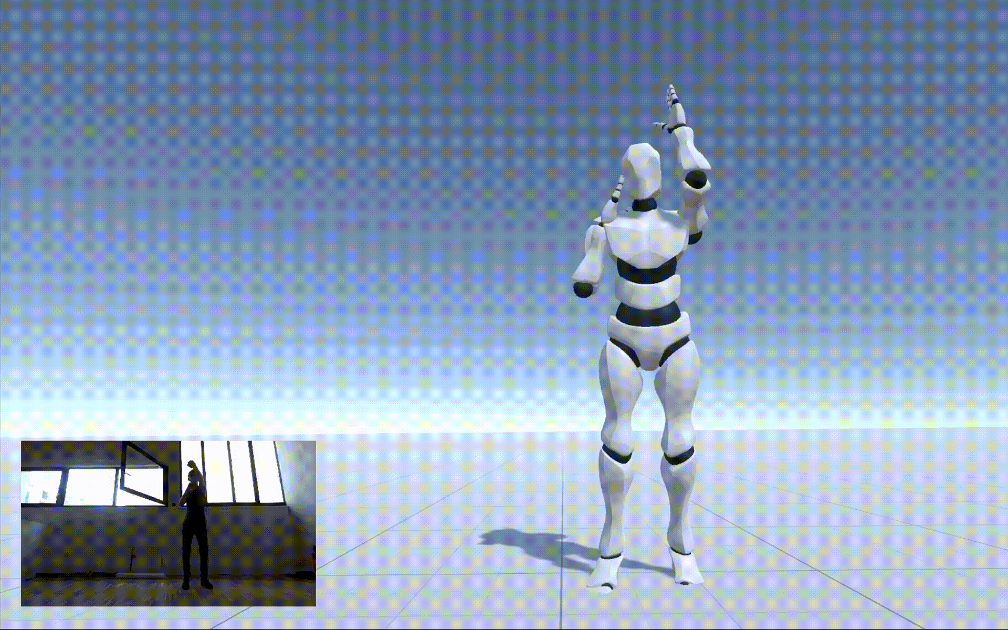
Body tracking with ZED2
Focus on person’s bones detection and tracking
Build keypoints between bones
Implement body fitting
recreates the skeleton based on the history of each tracked person to deduce missing keypoints

Slide 12

MediaPipe
Suite of libraries and tools for you to quickly apply artificial intelligence (AI) and machine learning (ML) techniques
Core functionality:
MediaPipe Tasks: cross-platform APIs and libraries
MediaPipe Models: pre-trained, ready-to-run models
MediaPipe Model Maker: Customize models

Slide 13
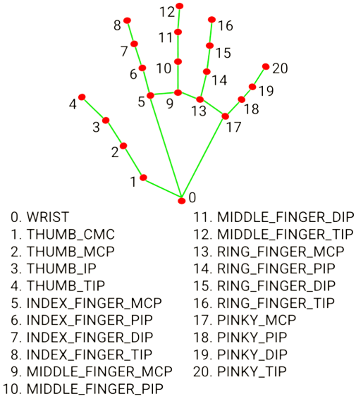
Hand landmark detection with MediaPipe
Task based on the detection of landmarks of the hands in an image.
Input: image data with a machine learning (ML) model as static data or a continuous stream
Output:
Hand landmarks in image coordinates and world coordinates
Handedness(left/right hand) of multiple detected hands

Slide 14
How the project will be structured

Slide 15
Two phases
“Static” referee signal recognition
“In game” referee signal recognition
Signal recognition with the referee still in front of the camera.
The challenges regards the classification of several signals the referee can do to signal the table of what happened in the match.
Referee signal’s recognition in a game.
The challenges will be regarding the identification of the referee on the field and various occlusions due to the movements of the players.
In both cases the main base ideas are to use:
Capture gesture with a ZED 2 camera
Elaborate hand lanmarks with MediaPipe

